Slide 1
Fundamentals of Programming

Slide 2
Programming – Why?
Computers are used for many different purposes in many different situations.
  But, how can they be so versatile?
    Answer: They can be programmed
The ability for a computer to be programmed allows it to do whatever their programs tell them what to do.
.

Slide 3
Program
A program is a set of instructions that tells the computer what to do.
Computer program - is a list of instructions that the computer follows to properly accept input, correctly process them and present the results in the most understandable way.
A computer cannot do anything unless it has a program to tell it what to do.

Slide 4
Computer Programming
Computer programming (often shortened to programming or coding), is the process of writing, testing, debugging/troubleshooting and maintaining act of instructions (source code) for solving a problem with the computer.
The purpose of programming is to create a program that exhibits a certain described behavior (customization).
The process of writing source code requires expertise in many different subjects, including knowledge of the application domain.

Slide 5
Programming
Programs are used to operate the components of a computer, solve problems or satisfy a want/need.
  How long will it take me to get home if I drive x miles per hour?
  I want to be able to tell my friends what I am doing right now.
  I want to be able to chat with my friends over the internet

Slide 6
Programming
Computer Programming is both an Art and a Science
  Every aspect of a program must be carefully designed
As an art, programming takes creativity and problem solving.
  There is often no one correct way to solve a problem.
As a science, there are formal and proven methods to go about creating a programming.

Slide 7
Steps in computer programming
To achieve this aim, you may proceed as follows.
First, understand the problem clearly:- Decide what you want to be calculated by the computer.
What will be the input data required? (if any). This is the problem formulation

Slide 8
Steps in computer programming
2. Write the steps of computation that are necessary to arrive at the solution. This is setting up the algorithm.
3. Prepare a flowchart corresponding to the algorithm.
4. Develop the computer program. Test and run it on the computer.

Slide 9
What is a programming language?
A programming language is a set of rules that provides a way of telling a computer what operations to perform.
A programming language is a set of rules for communicating an algorithm
It provides a linguistic framework for describing computations

Slide 10
Programming Language vs English
English is a natural language. It has words, symbols and grammatical rules.
A programming language also has words, symbols and rules of grammar.
The grammatical rules are called syntax.
Each programming language has a different set of syntax rules.

Slide 11
Programming Languages
Programming languages have evolved over time as better ways have been developed to design them.
  First programming languages were developed in the 1950s
  Since then thousands of languages have been developed
Different programming languages are designed for different types of programs.

Slide 12
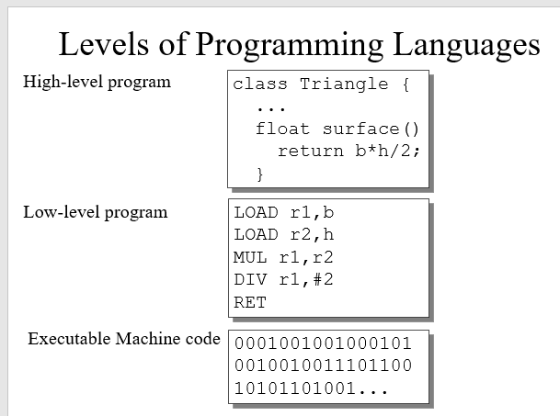

Slide 13
Types of programming Languages
1. Machine Language
2. Assembly Language
3. High level languages

Slide 14
Machine Language
Machine language is sometimes referred to as machine code or object code
machine language is a collection of binary digits or bits that the computer reads and interprets.
Machine language is the only language a computer is capable of understanding
While easily understood by computers, machine languages are almost impossible for humans to use because they consist entirely of numbers.

Slide 15
Internal Data Representation
The two common binary coding schemes normally used in data representation are the ASCII –and EBCDIC –codes.
-ASCII, which is an acronym for American Standard Code for Information Interchange was later extended to accommodate more special characters and the latter version was referred to as extended ASCII or ASCII-8.
-The latest of the versions is the ASCII-16 coding scheme which uses 16 bits. ASCII is the most widely coding scheme used in microcomputers.

Slide 16
Internal Data Representation
-Unicode or ASCII-16 which is a version of ASCII uses 2 bytes (16 bits) to represent a character, instead of 1 byte (8 bits) and therefore can handle 65,536 characters rather than just 256
•EBCDIC stands for Extended Binary Coded Decimal Interchange Codeis the most widely used scheme in mainframe computers.
Table 1.1 shows the codes for the uppercase alphabetic letters and numerical digits, 0 to 9. (See Table 1.1)

Slide 17
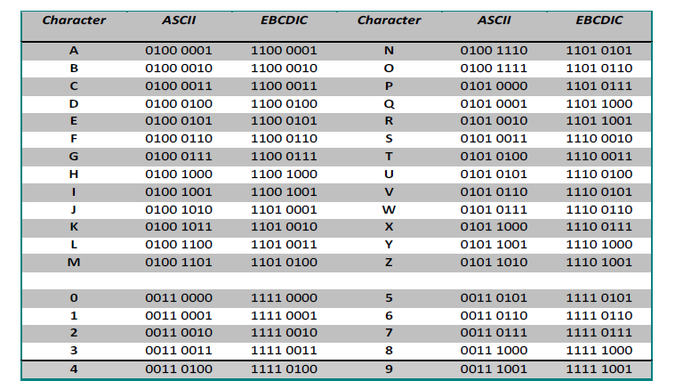
Table 1.1

Slide 18
Advantages of Machine Language
Machine language makes fast and efficient use of the computer.
This language is fastest in terms of execution in the sense that it does not need to be translated.
It requires no translator to translate the code. It is directly understood by the computer.

Slide 19
Disadvantages of machine language
1. Machine Dependent : Program written in machine language are machine dependent and hence program developed for one system does not execute on other system.
2. Complex Language for Programming : Since machine language consists only sequence of 0s and 1s, so it is very difficult for programmer to remember and write each instructions

Slide 20
Disadvantages of machine language
3. Error Prone : While programming using machine language everything need to be expressed in sequence of 0s and 1s which is very tedious task. So errors are frequently occurred while programming using machine language
4. Time Consuming : Writing program in machine language is time consuming process.

Slide 21
Assembly Language
Each personal computer has a microprocessor that manages the computer's arithmetical, logical, and control activities.
Each family of processors has its own set of instructions for handling various operations such as getting input from keyboard, displaying information on screen and performing various other jobs.
These set of instructions are called 'machine language instructions'.

Slide 22
Assembly Language
A processor understands only machine language instructions, which are strings of 1's and 0’s.
However, machine language is too obscure and complex for using in software development.
So, the low-level assembly language is designed for a specific family of processors that represents various instructions in symbolic code and a more understandable form.

Slide 23
Assembly Language
Instruction formed by using 1s and 0s i.e. using binary numbers are hard to remember and it is tedious to program using it.
In assembly language the binary bits are replaced by certain keywords which are known as mnemonic.

Slide 24
Assembly Language
These mnemonics are abbreviated letters which are much easier to remember.
In the above example, if 0100000011001100 is instruction used to add two numbers, then ADD would be the easiest mnemonic to remember for it.
This language is easier to learn than machine language

Slide 25
Assembler
This type of software translates and assembles a program written in assembly code into machine (object) code.
•The assembler translates the symbolic function codes into the equivalent machine operation code.
E.g. DIV SUM, NUMB
•After assembling, the object program is retained on a storage device in machine code.

Slide 26
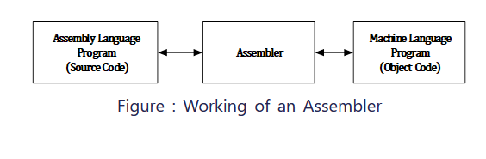
Assembler
An assembler is used to convert programs written in assembly language into machine language.
It is still faster as compared to high level language but slower than lowest level language (Machine language) due to the requirement of translation.
https://www.codesansar.com/computer-basics/assembly-language.htm

Slide 27
Advantages of Assembly Language
1. Easy to Understand and Use: Assembly language uses mnemonic codes which are easy to use and remember.
So, errors which can occur while writing program using assembly language are less as compared to writing program using machine language.
Also, assembler provides a way to locate and correct errors.
2. Speed: Program written in assembly language executes faster than program written high level language.

Slide 28
Disadvantages of Assembly Language
1. Machine Dependent: Program written in assembly language are machine dependent and hence program developed for one system does not execute on other system.
2. Difficult to Learn :Since assembly language is machine dependent so every type of computer architecture requires a different assembly language. Programmer need to study and understand different mnemonic code according to the architecture used.
3. Slow Program Development Time: Developing program in assembly language is slow process as compared to high level language.

Slide 29
High Level Programming Languages
High-level programming languages are so-called third-generation languages,
  whereas low-level languages can be described as first-generation (machine code) and
  second-generation (assembly language) languages.
This is because high-level programming languages were invented after machine code and assembly language.
.

Slide 30
High Level Languages
High level language is much closer to human language
High level languages are written in a form that is close to our human language, enabling to programmer to just focus on the problem being solved.
High level languages are often not dependent of the particular type of computer used (i.e. more portable) and has its own set of rules called syntax.

Slide 31
High Level Languages
Its main advantage is that it is easier to read, write and maintain.
The first high level programming languages were designed in the 1950s.
Now there are dozens of such languages available such as BASIC, COBOL, C, C++, FORTRAN, LISP, PASCAL, prolog, etc.

Slide 32
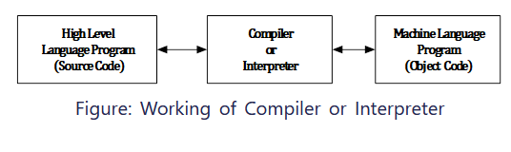
Compilers and Interpreters
Compiler or interpreter is used to convert high level language to machine language.

Slide 33
Advantages of High Level Languages
1. Easy to Use and Understand : High level language uses English like words and they are closer to natural language which makes easy to learn and understand. Programmer need not to understand detailed computer architecture for writing programs using high level language.
2. Machine Independent : Programs written in high level language are portable and hence program written using high level language can be executed on any type of computer with little or no modification at all.

Slide 34
Advantages of High Level Languages
3. Debugging is Easy : High level language makes easier to write and debug a program and gives the programmer time to think about overall logic rather than thinking about program code. Because of the use of compilers and interpreters, errors can be detected and located easily.
4. Easy to Maintain Program : Modification and maintenance of program written in high level language is easy compared low level language.

Slide 35
Disadvantages of High Level Languages
1. Poor Control on Hardware: Since high level languages are away from hardware and programmer does not need to be aware of hardware, accessing and controlling hardware directly is difficult.
2. Slow Execution: Program written in high level language need to be translated to machine language. This translation process increases the execution time of program.

Slide 36
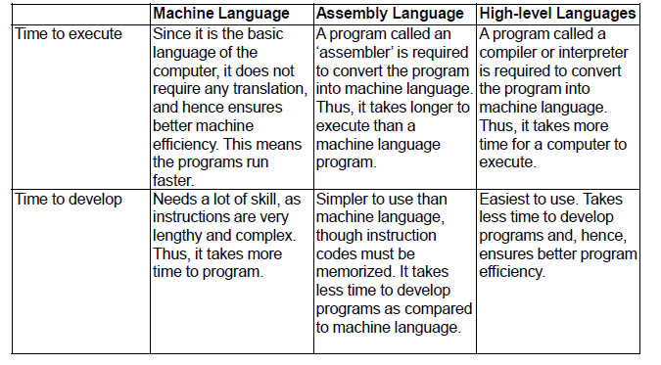

Slide 37
Language Translators
Language translators are generally used by Computer Programmers.
•These programmers normally write Computer Programs using languages such as COBOL, FORTRAN, C++, Visual Basic, etc in which instructions are written close to mathematical and English-like expressions.
E.g. NetPay= GrossPay-Deductions
•These instructions tend to be meaningful to the programmer and not the computer as the computer understands only the machine language.

Slide 38
Language Translators
Since the program is not in the language that the Computer has been designed to understand, there is the need to have a program translator.
•A program translator may be defined as any computer package capable of translating a source program written in either a high level language or an assembly language into a machine language.
•There are three types of program translators namely Compilers, Interpreters and Assemblers.

Slide 39
Interpreter
Every program instruction is translated or interpreted on each occasion the program is run (not just once initially as with assemblers and compilers).
•If any statement does not conform to or violates the rules or grammar (syntax) of the language an error message is displayed on the screen.
•Until this error is corrected, program execution cannot proceed and this has the disadvantage of slowing down the running of the program.
•An interpreter, however, allows errors to be corrected more quickly than a compiler which prints a (long) list of errors which have to be corrected as a whole rather than individually before program execution can continue.

Slide 40
Interpreter
•An interpreter, however, allows errors to be corrected more quickly than a compiler which prints a (long) list of errors which have to be corrected as a whole rather than individually before program execution can continue.

Slide 41
ASSEMBLER
•As mentioned earlier, This type of software translates and assembles a program written in assembly code into machine (object) code.
•The assembler translates the symbolic function codes into the equivalent machine operation code.
E.g. DIV SUM, NUMB
•After assembling, the object program is retained on a storage device in machine code.

Slide 42
Compiler
A compiler is a program that translates a source program written in some high-level programming language (such as Java) into machine
The generated machine code can be later executed many times against different data each time.

Slide 43
ALGORITHMS
Computer programming can be divided into two phases:
Problem solving phase
  Make an ordered sequence of steps that solves a problem.
  This sequence of steps is called an algorithm.
Implementation phase
  Implement using a programming language.

Slide 44
Algorithm:
The algorithm is part of the blueprint or plan for the computer program, an algorithm is:
“An effective procedure for solving a class of problems in a finite number of steps.”
Every algorithm should have the following 5 characteristic feature:
      Input
      Output
      Definiteness
      Effectiveness
      Termination

Slide 45
Algorithms
Features of an Algorithm
1. It should be simple
2. It should be clear with no ambiguity
3. It should head to unique solution of the problem
4. It should involve a finite number of steps to arrive at a solution
5. It should have the capability to handle unexpected situation.

Slide 46
Class activities
Write and algorithm to:
1. Withdraw 500 cedis from an ATM machine
2. fry egg
3. find the average of two numbers

Slide 47
Why do we need algorithms?
If we wish to build a house, we need to design it first.
• Can you think of some possible consequences of not designing a house before building it?
• Similarly, computer programs (especially large and complex ones) need to be designed before they are written.
Can you think of some possible consequences of not designing a program before building it?
• One of the things considered when designing a computer program is the algorithm which it will be based on.

Slide 48
Types of Operations
Basic operations eg.
  Wet hair
  Rinse
  Turn on VCR
Conditional operations
  If flour is too dry add water
Repeat/looping operations
  Repeat step 1 and 2 three times
  Repeat steps 2,3,4,…10 until flour becomes soft.

Slide 49
Expressing algorithms
Is natural language good?
  For daily life, yes…but for CS is lacks structure and would be hard to follow
  Too rich, ambiguous, depends on context
How about a programming language?
  Good, but not when we try to solve a problem..we want to think at an abstract level
  It shifts the emphasis from how to solve the problem to tedious details of syntax and grammar.

Slide 50
Methods used to represent algorithms
The following methods could be used to represent an algorithm.
Methods of Flowchart
Methods of Pseudo code
Methods of Decision table
Methods of Data flow Diagram (DFD)

Slide 51
Pseudocode

